Slide 1

Getting PHP Hosting
Dr. Charles Severance
Notes:
Note from Chuck. If you are using these materials, you can remove my name and URL from this replace it with your own, but please retain the CC-BY logo on the first page as well as retain the entire last page when you remix and republish these slides.

Slide 2
What We Need
We want to be able to put up our application on the web so anyone can access our URL (and so we can grade it)
You have many choices
Free Hosting - limited bandwith - but OK for this class
UMSI Hosting - Free as long as you are an SI student or in an SI class
Pay for hosting - starting at less than $5.00 per month

Slide 3
UMSI-Provided Hosting
http://csev.people.si.umich.edu/
Must use VPN if cnnecting from off-campus
http://www.itcom.itd.umich.edu/vpn/
Allows remote shell access (SSH) - no free hosting gives shell access
https://blinky.si.umich.edu/confluence/display/SIC/Personal+People+Site

Slide 4
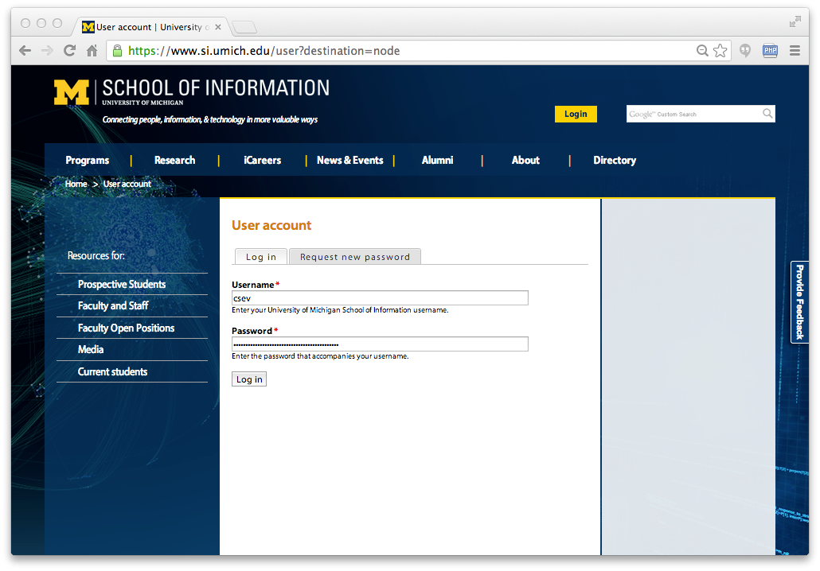

Slide 5
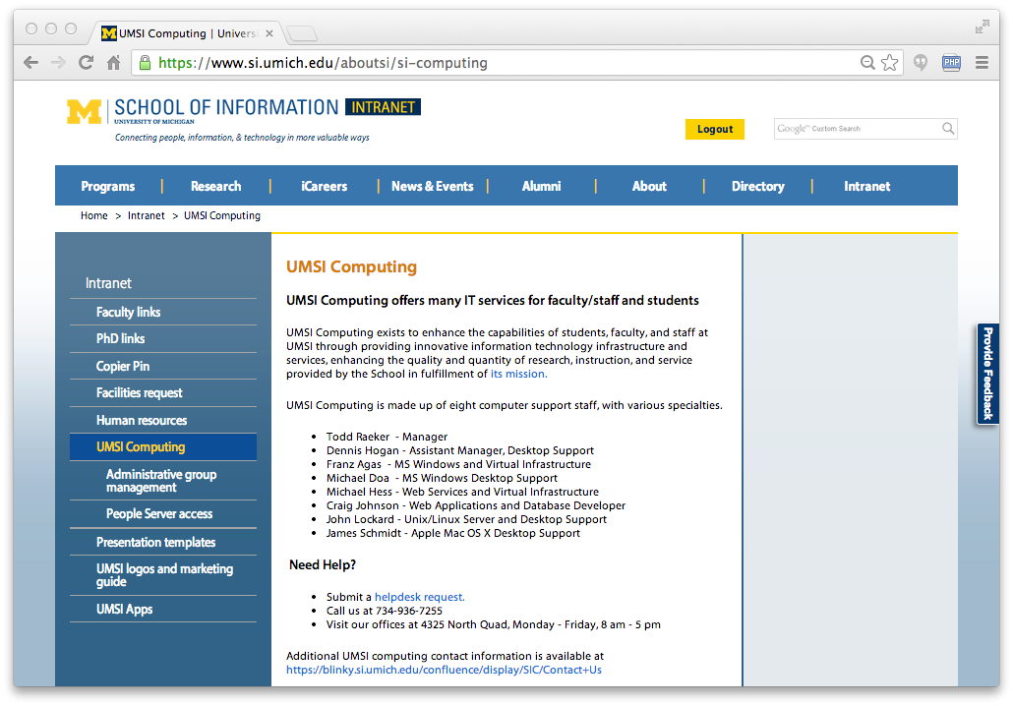

Slide 6
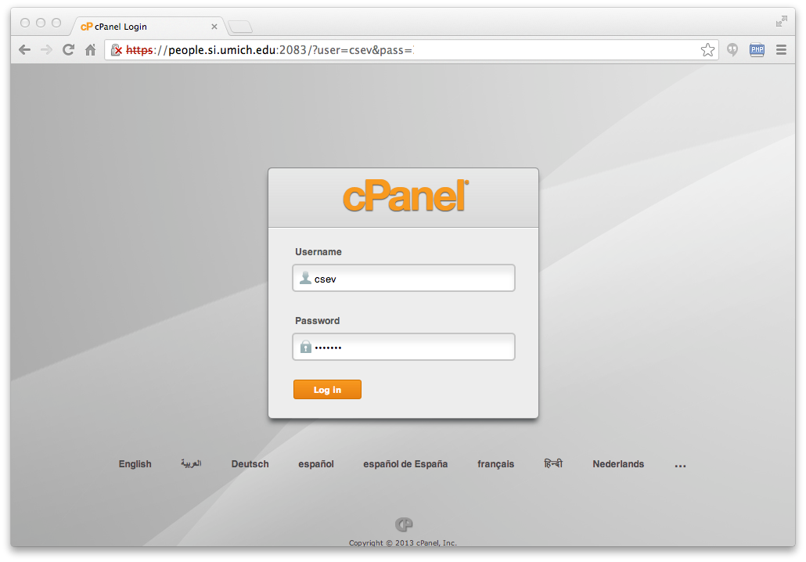
You must be on campus or use the VPN

Slide 7
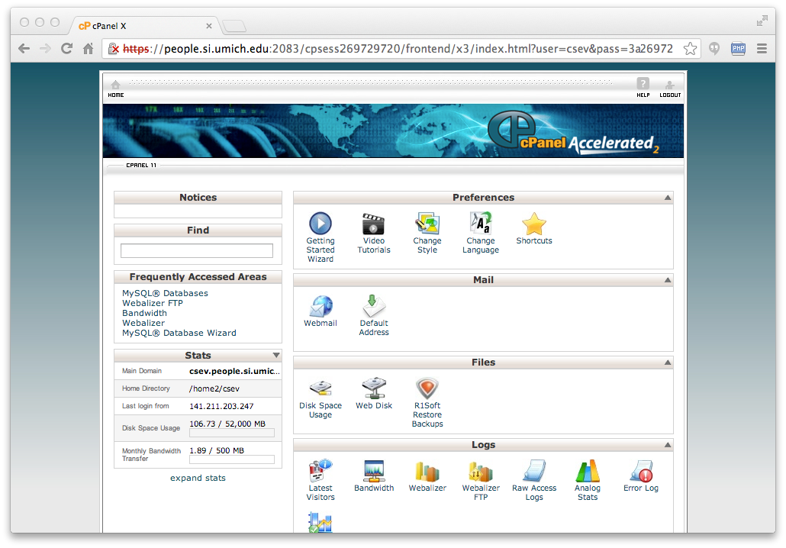

Slide 8
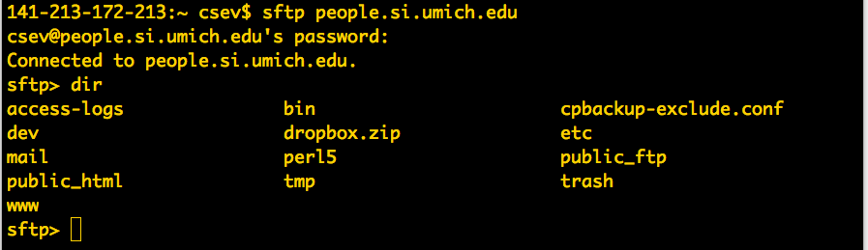

Slide 9
Free PHP / MySQL Hosting
These are fully functional services on solid hardware from real companies
They are a loss leader - want to get you comfortable and then get you to pay $3.00 per month or more
They will spam you here and there - especially is you use it a lot
Bandwidth and data size limitations - but plenty for this course

Slide 10
Some Free Hosting Choices
http://www.byethost.com
http://www.awardspace.com/
http://www.zymic.com/
http://www.000webhost.com/
https://x10hosting.com/
.. search for "Free PHP/MySQL hosting"

Slide 11
www.byethost.com
They use a standard CPanel
They only ask for limited personal info (i.e. no phone)
Don't worry about the exact limitations - if your site starts getting real traffic - you should pay anyways

Slide 12
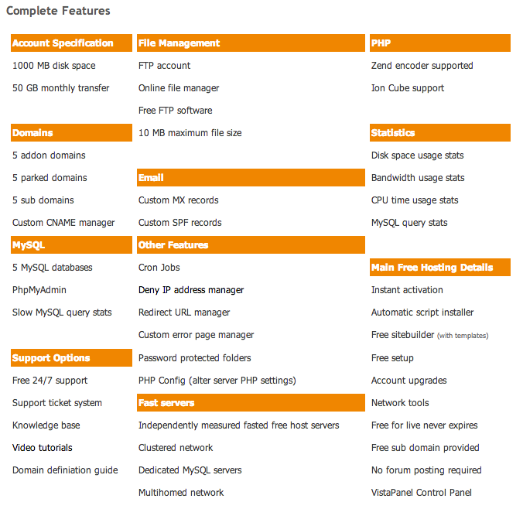
http://byethost.com/index.php/free-hosting

Slide 13
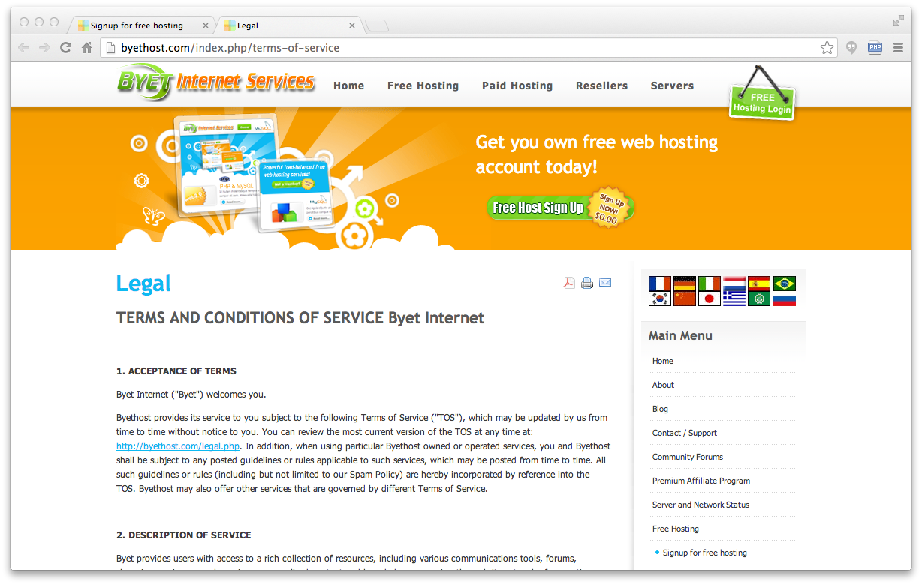

Slide 14
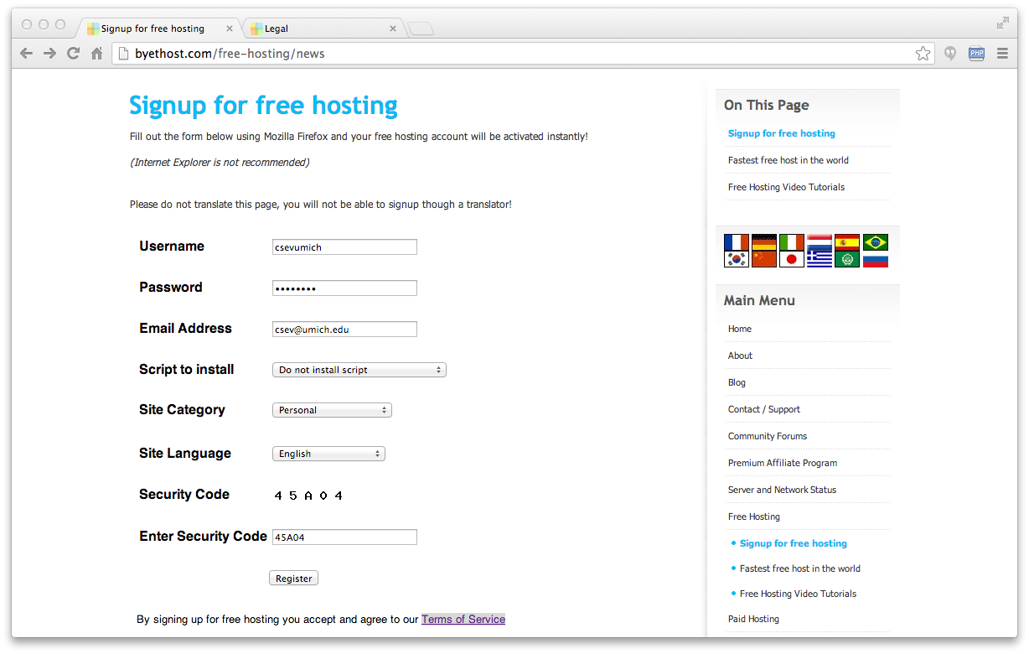

Slide 15
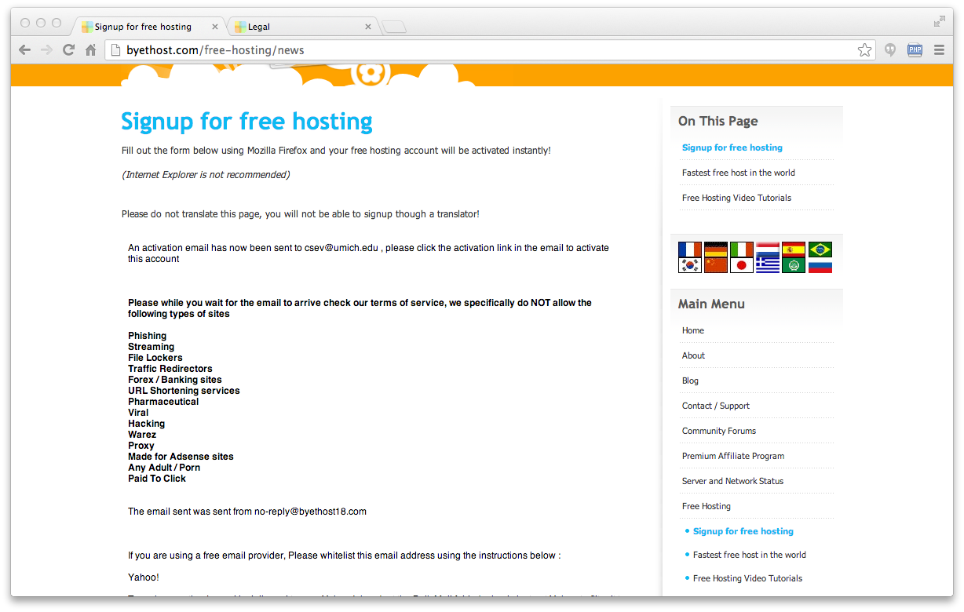

Slide 16
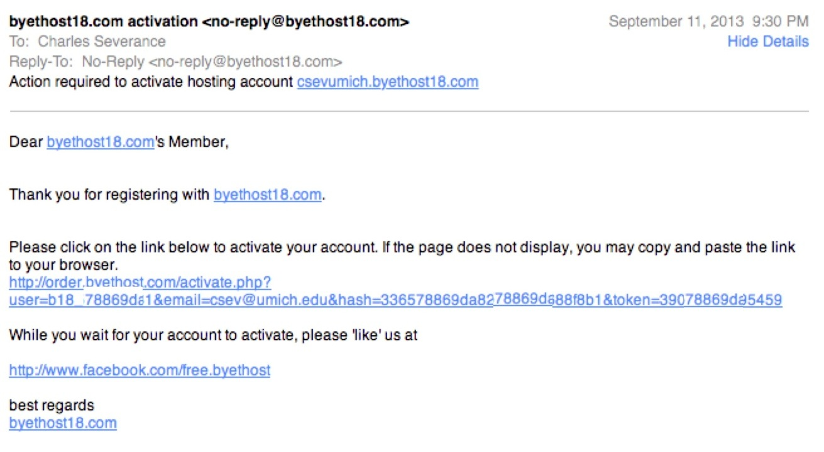

Slide 17
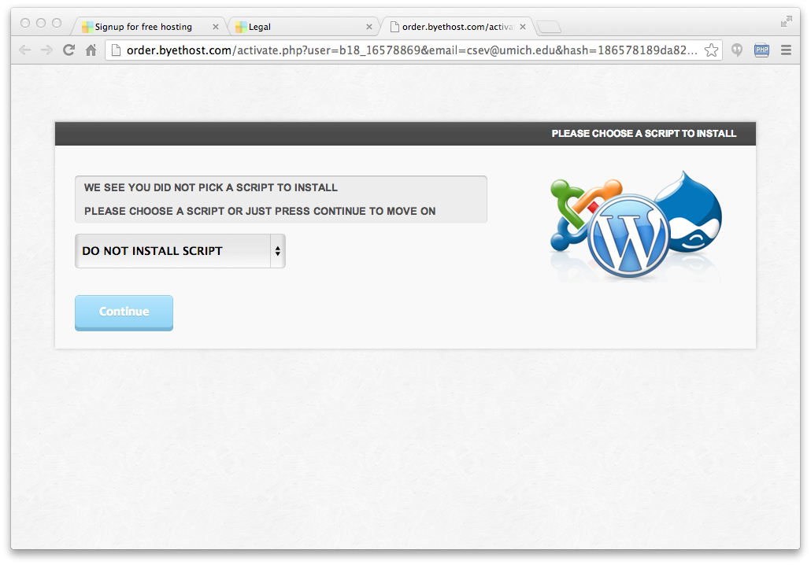
It takes a while....

Slide 18
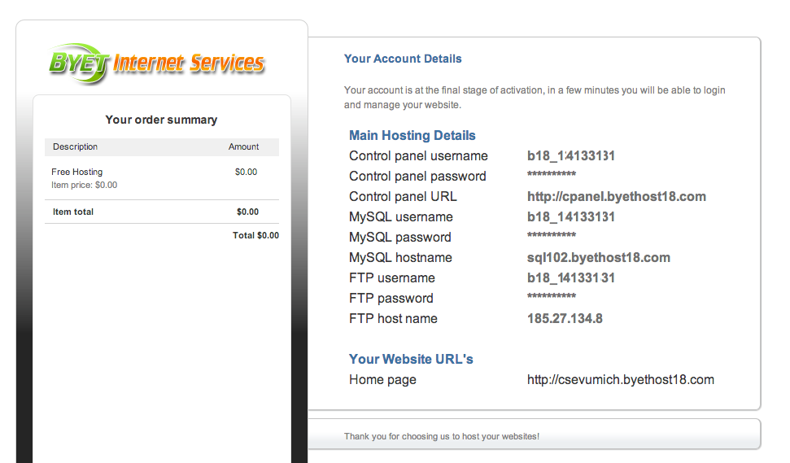
Give this 30 minutes to work

Slide 19
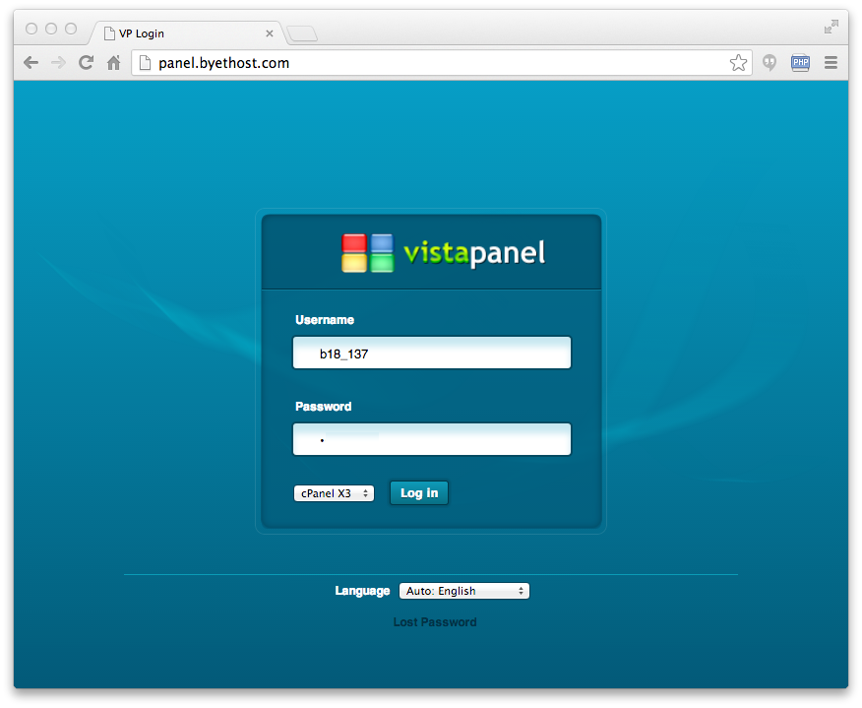

Slide 20
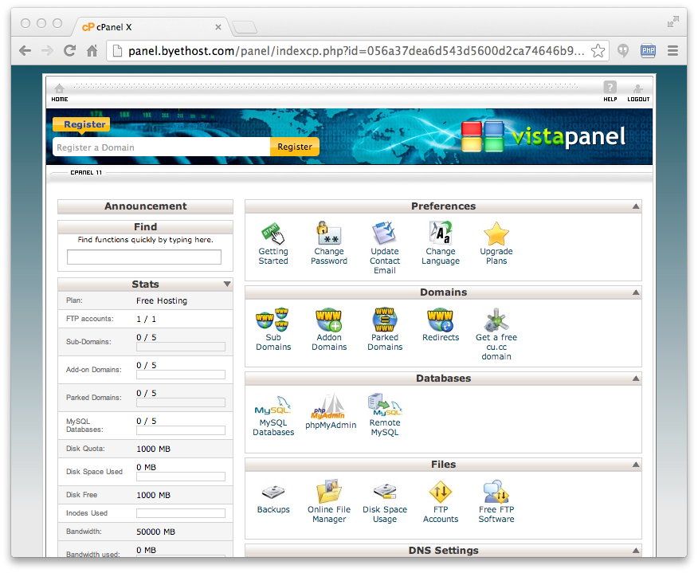

Slide 21
CPanel
CPanel is a very nice and very standard system administration tool kit for hosted systems
Server configuration
Database setup
PHPMyAdmin
File Management
.....

Slide 22
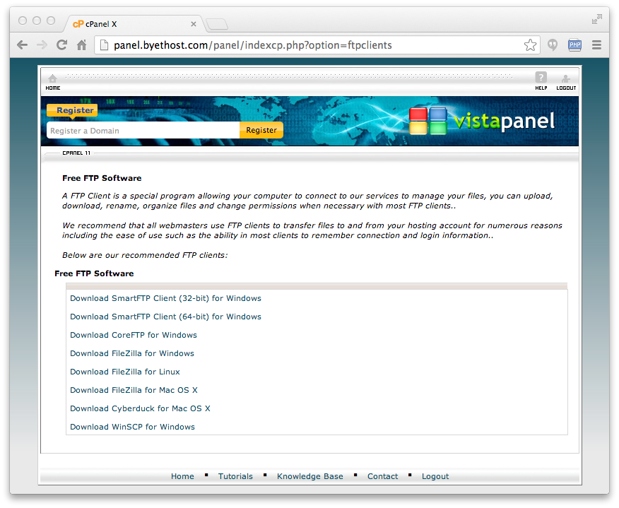
Pick One

Slide 23
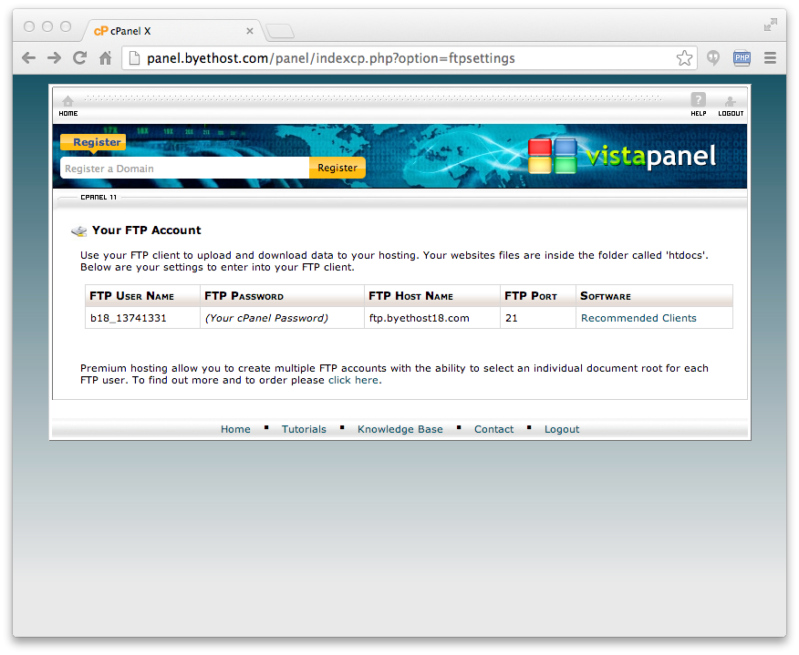
Uploading Files

Slide 24
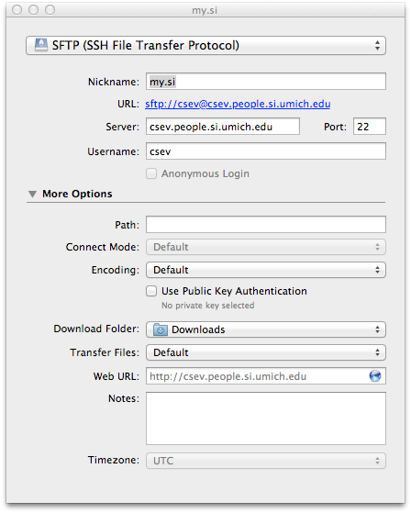
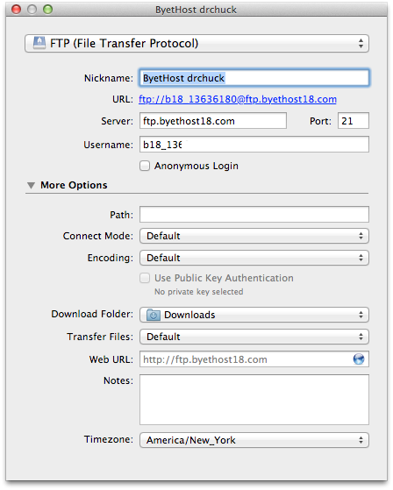
CyberDuck

Slide 25
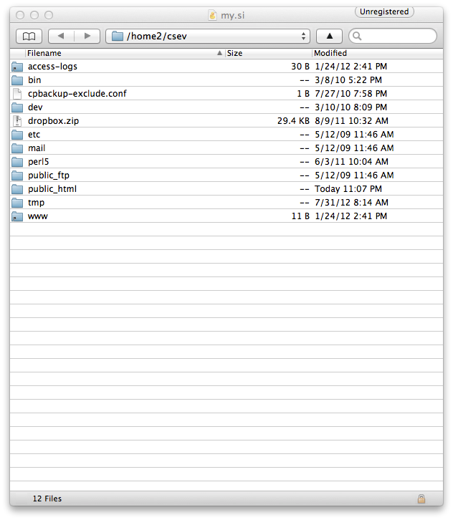
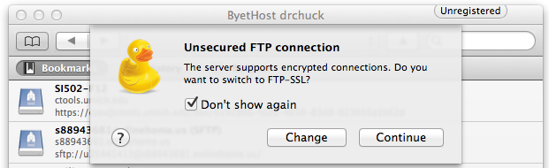
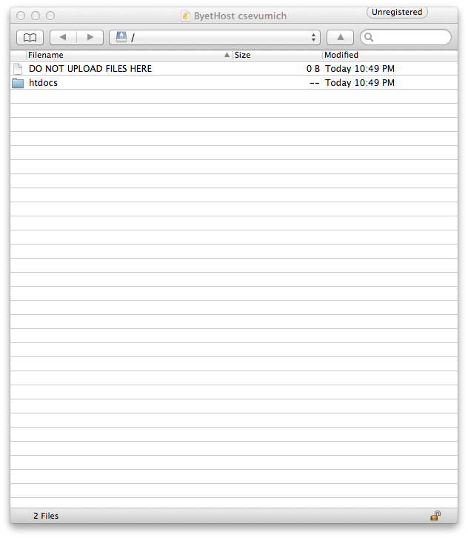

Slide 26
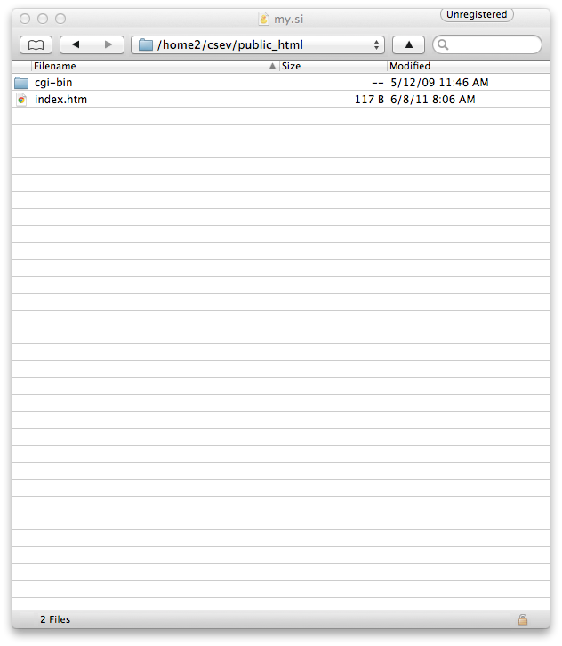
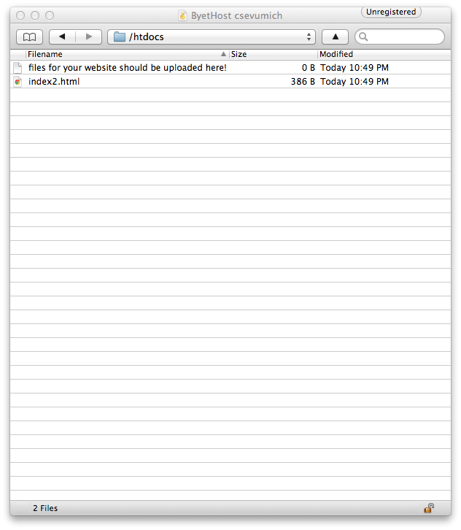

Slide 27
howdy.php
<h1>Hello from Dr. Chuck's HTML Page</h1>
<p>
<?php
echo "Hi there.\n";
$answer = 6 * 7;
echo "The answer is $answer, what was the question again?\n";
?>
</p>
<p>Yes another paragraph.</p>

Slide 28
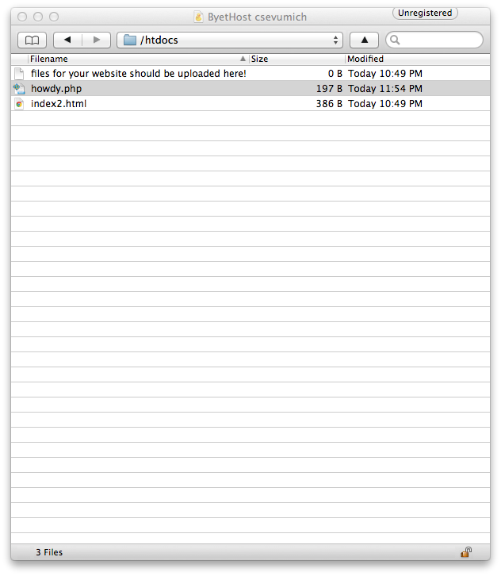
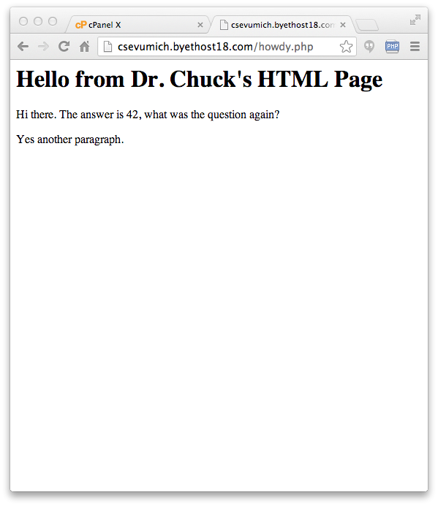
Remember - it can take up to 30 minutes for a domain name to propogate when you create a Byethost account.

Slide 29
Summary
You will need a real on-the-web site to turn your assignments for the class
SI People Server
Free hosting like ByetHost
Learn CPanel
Install and use a FTP tool

Slide 30
Acknowledgements / Contributions
These slides are Copyright 2010- Charles R. Severance (www.dr-chuck.com) as part of www.php-intro.com and made available under a Creative Commons Attribution 4.0 License. Please maintain this last slide in all copies of the document to comply with the attribution requirements of the license. If you make a change, feel free to add your name and organization to the list of contributors on this page as you republish the materials.
Initial Development: Charles Severance, University of Michigan School of Information
Insert new Contributors and Translators here including names and dates
Continue new Contributors and Translators here
Notes:
Note from Chuck. Please retain and maintain this page as you remix and republish these materials. Please add any of your own improvements or contributions.

